Slide 1
Using Machine Learning to Identify True Variants for Precision Medicine
Cong Zhang, MS in Biostatistics
Practicum supervisors: Hila Milo Rasouly, Sarath Babu Krishna Murthy, Shiraz Bheda
Organization: Center for Precision Medicine and Genomics, Columbia University

Slide 2
Background/Introduction
DNA sequencing together with other genomic technologies has been used to identify disease- gene associations in precision medicine. Deferent tools are used in the workflows of DNA sequencing to identify variants which could be associated with disease of interest.
However, many identified variants are actually artifacts, leading to less precise diagnoses. Therefore, it is crucial to differentiate real variants from misleading artifacts for more precise diagnoses.
The goal of this project is to build a predictive model for identification of true variants. Multiply statistical and machine learning models are explored in this project, including generalized linear regression, regularized regression, and random forests, etc. The performance of different models are evaluated using 10-fold cross-validation.

Slide 3
Data
Research data used in this project is the genetic data of patients with renal diseases, collected by the Center for Precision Medicine and Genomics of Columbia University.
Original Observed Response |  |  | Transformed Model Response
Name | Value | Frequency | Frequency | Value | Name
filter | PASS | 22113 | 22113 | variant | if_variant
 | LIKELY | 617 | 1351 | artifact
 | INTERMEDIATE | 527
 | FAIL | 207

Slide 4
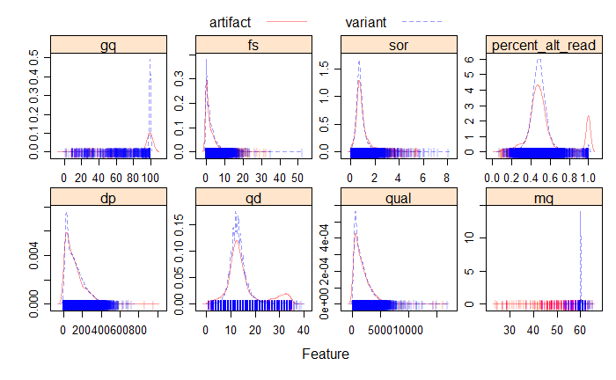
Data
Key Predictors

Slide 5
Methods
Weighted Models for Rare Events (94.25% Variants vs. 5.75% Artifacts):
Logistic Regression
Logistic Regression with Ridge Penalty
Logistic Regression with LASSO Penalty
Logistic Regression with Elastic Net Penalty
Generalized Additive Model (GAM)
Multivariate Adaptive Regression Splines (MARS) Model
Random Forests Model

Slide 6
Statistical Analysis/Results
 | Cross-Validation | Test Data Prediction | Test Data | Test Data
Model | AUC | Accuracy | Sensitivity | Specificity
Logistic | 0.7735633 | 0.7033 | 0.7044 | 0.6855
Ridge | 0.7530044 | 0.7030 | 0.7064 | 0.6469
LASSO | 0.7733503 | 0.7362 | 0.7401 | 0.6736
Elastic Net | 0.7733806 | 0.7362 | 0.7402 | 0.6706
GAM | 0.6726756 | 0.9395 | 0.9942 | 0.0415
MARS | 0.8269858 | 0.7499 | 0.7525 | 0.7062
Random Forests | 0.8243109 | 0.7117 | 0.7124 | 0.7003

Slide 7
Conclusions
According to the cross-validation AUC values, MARS is the optimal model in the project.
For rare events, models with inverse weights have achieved much higher specificities.
Try other methods to address rare events.
Try to use the original ordinal response and conduct proportional odds logistic regression.
Try to include more data and deal with imbalanced dataset.

Slide 8
Reference
[1] Bomba, L., Walter, K., & Soranzo, N. (2017). The impact of rare and low-frequency genetic variants in common disease. Genome biology, 18(1), 1-17.
[2] Chen, J., Li, X., Zhong, H., Meng, Y., & Du, H. (2019). Systematic comparison of germline variant calling pipelines cross multiple next-generation sequencers. Scientific reports, 9(1), 1-13.
[3] Cornish, A., & Guda, C. (2015). A comparison of variant calling pipelines using genome in a bottle as a reference. BioMed research international, 2015.
[4] King, G., & Zeng, L. (2001). Logistic regression in rare events data. Political analysis, 9(2), 137-163.
[5] Kumaran, M., Subramanian, U., & Devarajan, B. (2019). Performance assessment of variant calling pipelines using human whole exome sequencing and simulated data. BMC bioinformatics, 20(1), 1-11.
[6] Li, M. M., Datto, M., Duncavage, E. J., Kulkarni, S., Lindeman, N. I., Roy, S., ... & Nikiforova, M. N. (2017). Standards and guidelines for the interpretation and reporting of sequence variants in cancer: a joint consensus recommendation of the Association for Molecular Pathology, American Society of Clinical Oncology, and College of American Pathologists. The Journal of molecular diagnostics, 19(1), 4-23.
[7] Ren, Z., Povysil, G., Hostyk, J. A., Cui, H., Bhardwaj, N., & Goldstein, D. B. (2021). ATAV: a comprehensive platform for population-scale genomic analyses. BMC bioinformatics, 22(1), 1-15.
[8] Richards, C. S., Bale, S., Bellissimo, D. B., Das, S., Grody, W. W., Hegde, M. R., ... & Ward, B. E. (2008). ACMG recommendations for standards for interpretation and reporting of sequence variations: Revisions 2007. Genetics in Medicine, 10(4), 294-300.

